Slide 1
TOWARDS ZERO-WASTE STRUCTURES THROUGH INTEGRATION OF RECLAIMED WOOD AND 3D PRINTING
P5 Presentation
Aron Arend Bakker
5658004

Slide 2
Context
40% of primary energy goes to the building industry (European Commission, 2017)
The EU pushes for greater reuse of building components (Didier, 2018)

Slide 3
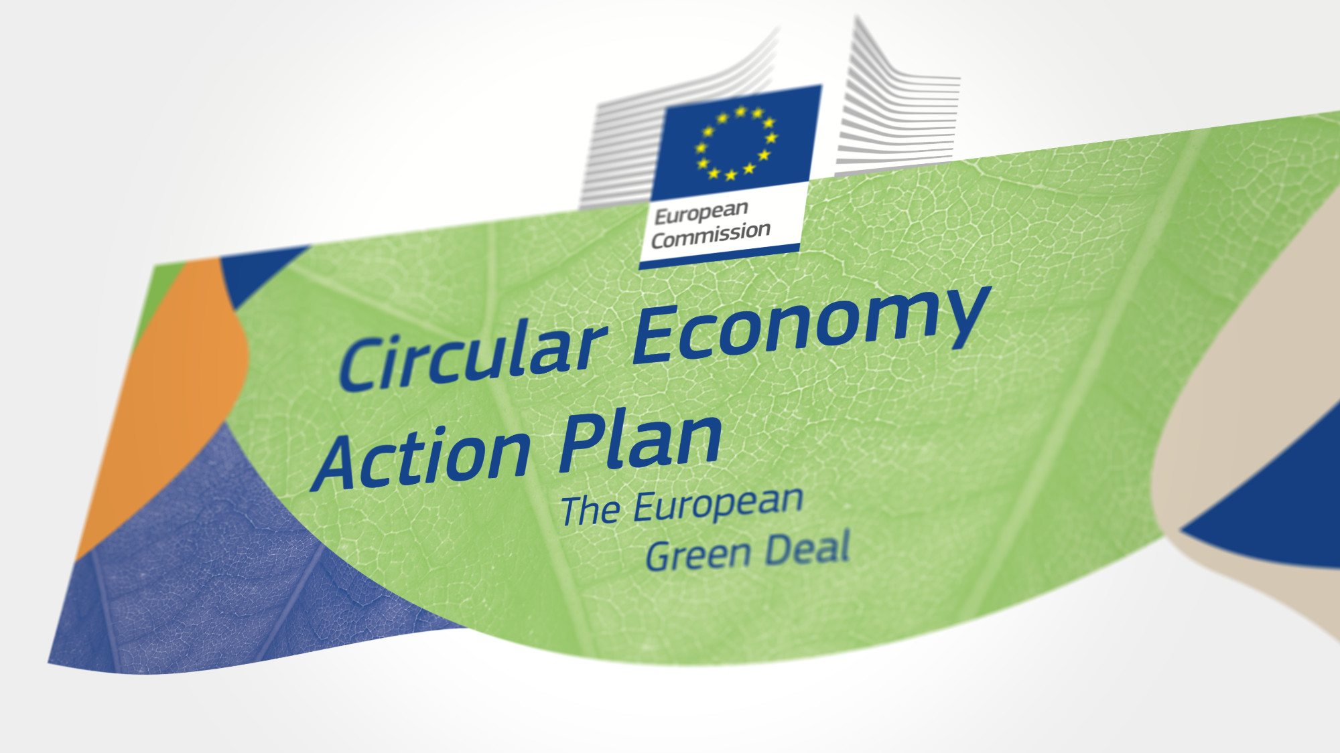
Circularity
https://www.google.nl/url?sa=i&url=https%3A%2F%2Fwww.forfreechoice.org%2Ffreedomofchoice%2Fcircular-economy%2F&psig=AOvVaw3vGkHZZTIwZ37z1rRQAiNr&ust=1719046886970000&source=images&cd=vfe&opi=89978449&ved=0CBEQjRxqFwoTCJC2oPKq7IYDFQAAAAAdAAAAABAR

Slide 4
What is the circular economy?
https://www.inboundlogistics.com/articles/the-road-to-the-circular-economy/

Slide 5
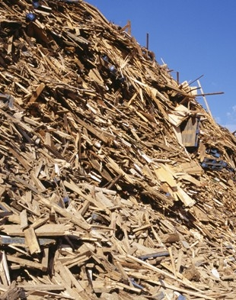
Current standing….
https://www.mrw.co.uk/subject/editorial/page/1063/?cmd=pagesize&val=20

Slide 6
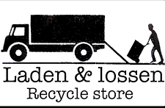
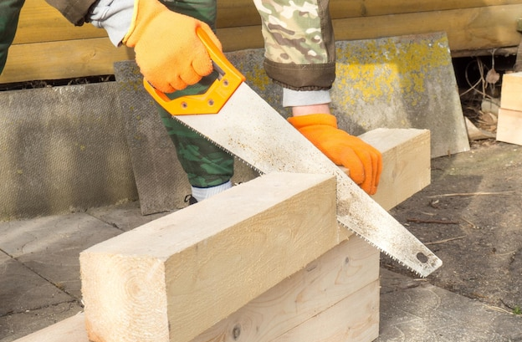
So, what seems to be the problem?
Design with a constrained stock increases the complexity of a design project
Circular material hubs provide storage
A dynamic stock of elements increases complexity
Stock constrained design tools give complex connections
Connections damage the reused elements.
Remanufacturing is required, creating saw-off losses.
https://www.freepik.com/premium-photo/process-manual-sawing-timber-man-sawing-timber-when-building-house_27069459.htm

Slide 7
For example:
Like IKEA without instructions
None of the right elements
Nothing matches
https://www.shutterstock.com/nl/image-photo/worried-woman-moving-into-new-apartment-663880423
https://vimeo.com/654116098

Slide 8
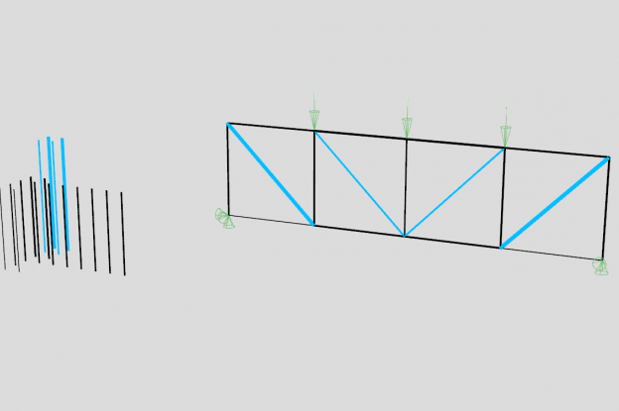
How can we solve this problem?
Stock-constrained design
Example: Reused/New elements
Example of stock-constrained designed structure
https://www.epfl.ch/labs/sxl/tools/phoenix3d/

Slide 9
What is stock constrained design?
https://www.epfl.ch/labs/sxl/tools/phoenix3d/

Slide 10
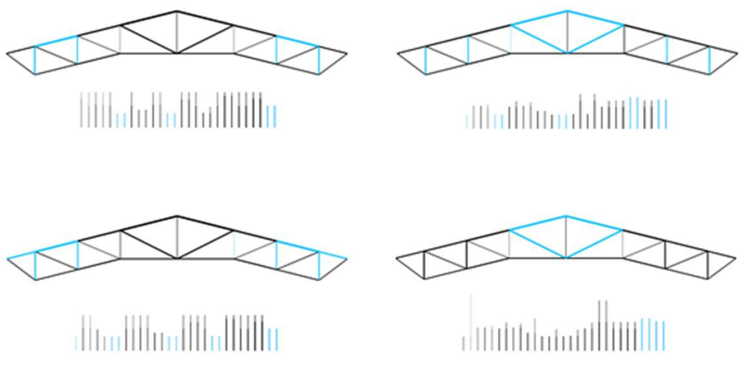
Disadvantages stock-constrained design
Creates complex and unique joints
Will use larger elements than necessary, creating saw-off loss
Fills gaps with new elements
https://www.researchgate.net/figure/a-shows-the-optimal-structure-designs-and-element-usage-for-stocks-A-B-and-C-when_fig3_354270307

Slide 11
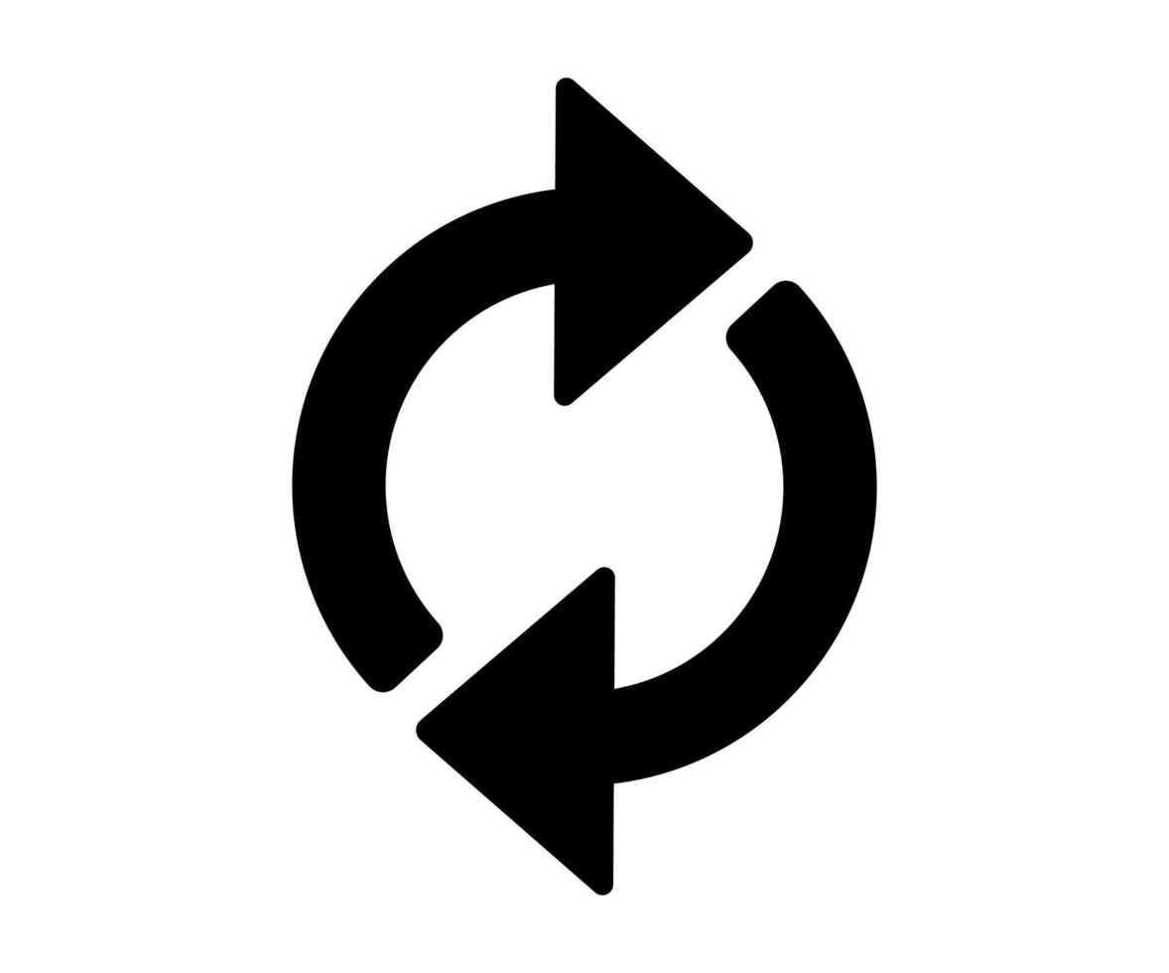
The proposed solution!
Make connections grow towards elements
Element >= element required
No saw-off!
Substract material
https://external-content.duckduckgo.com/iu/?u=https%3A%2F%2Fi.redd.it%2Fnssgg09wcxe31.jpg&f=1&nofb=1&ipt=14d75fbdc56d6c583a62013f21d4a5b4d418125f0cd4cbf65037c5e64c2f6f06&ipo=images
Add material

Slide 12
How? Topology optimization + 3D printing
https://www.researchgate.net/figure/3D-printed-wooden-furniture-connectors-2_fig1_375886252

Slide 13
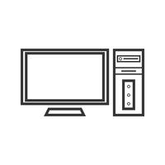
The research question
“Can stock-constrained digital design combined with 3D printing support the reuse of wooden structural elements without saw-off losses in a sustainable way?”

Slide 14
The desired end results
A design tool
LCA results
?
?
?
?
?

Slide 15
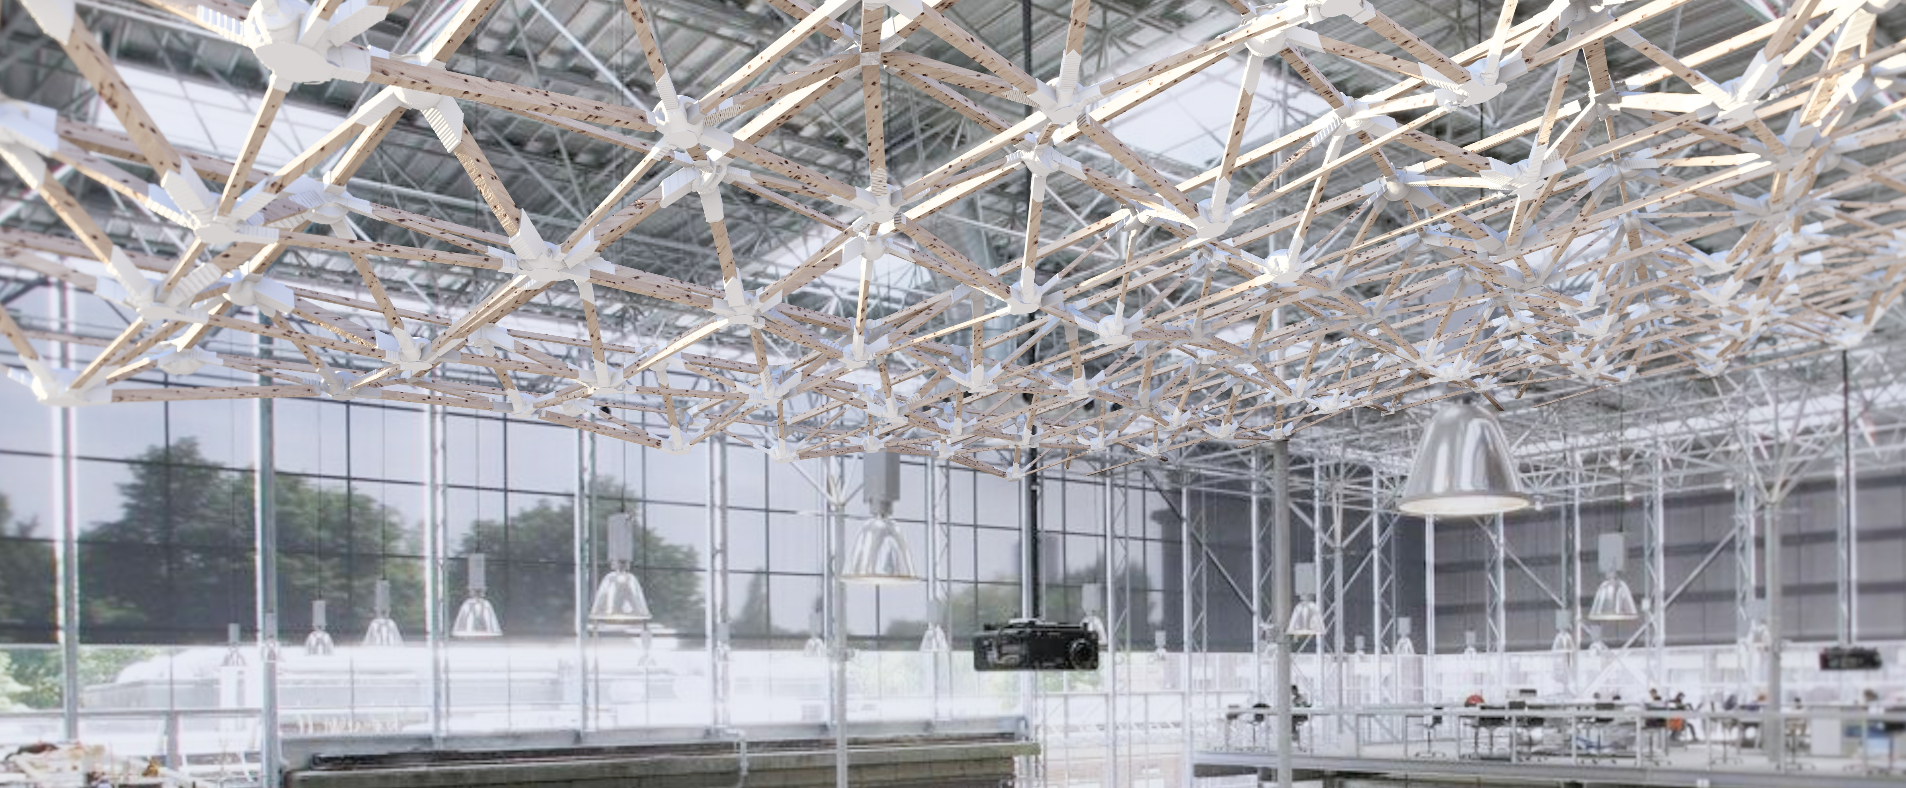
The casestudy

Slide 16
The scenario’s

Slide 17
Scenario 1

Slide 18
Scenario 2

Slide 19
Scenario 3

Slide 20
Scenario 4

Slide 21
Scenario 5

Slide 22
The scenario’s
Scenario 1
Scenario 2
Scenario 3
Scenario 5
Scenario 4
?
?
?
?
?

Slide 23
The workflow
The stock
Creation of the raised roof frame
Creating the freedom of motion
Stock-constrained optimization
Setup for geneation of the joints
Generating
LCA results

Slide 24
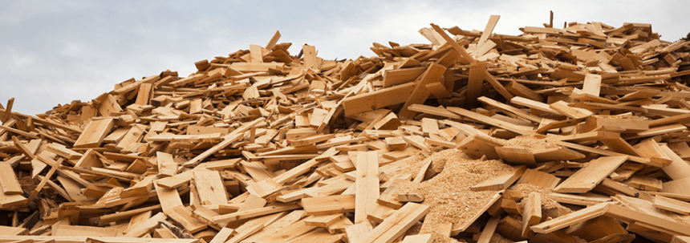
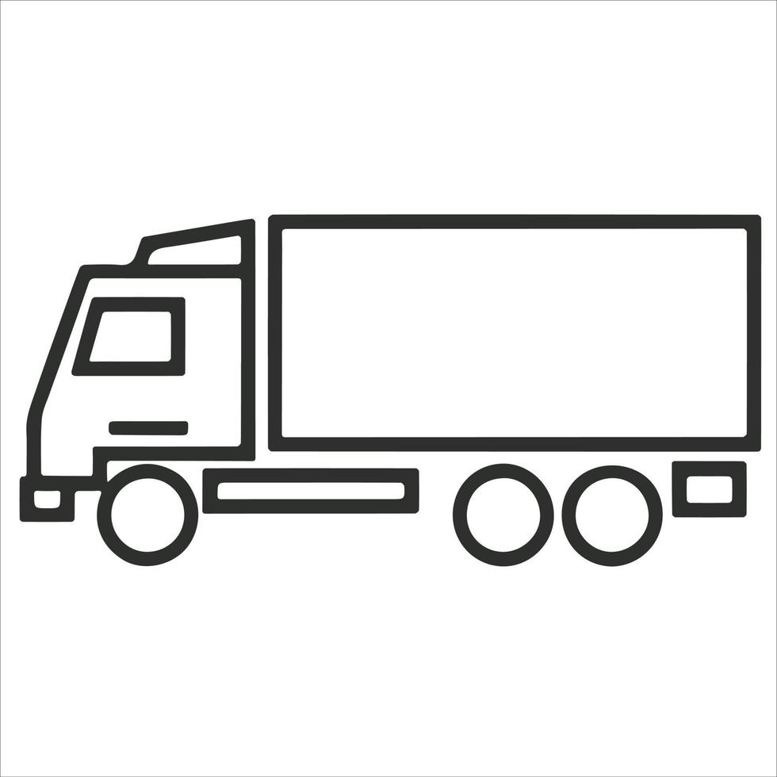
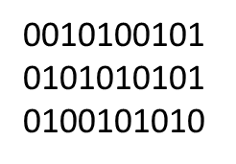
The stock
Reclaimed timber
Circulair hub
3D-digital copies for library
https://encrypted-tbn2.gstatic.com/images?q=tbn:ANd9GcSnmCTwDgEoYhbhAsd5nQcgTsUhzaNseO4IdkPnF7eGr_m657ch

Slide 25
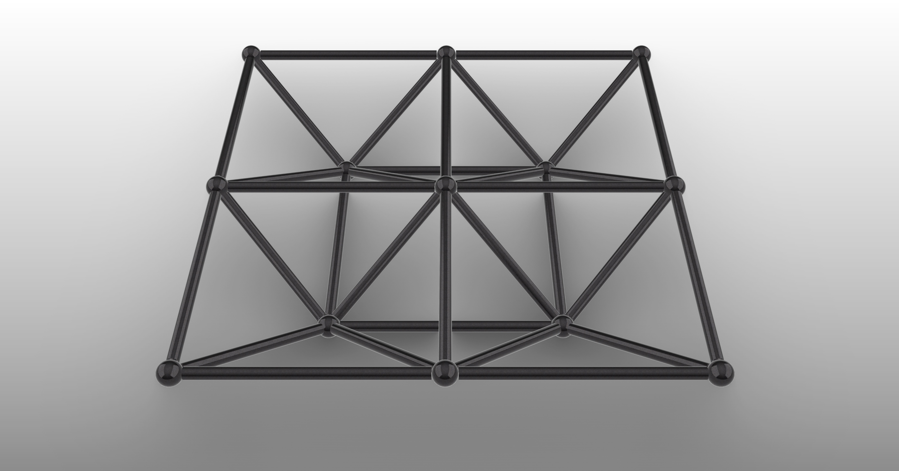
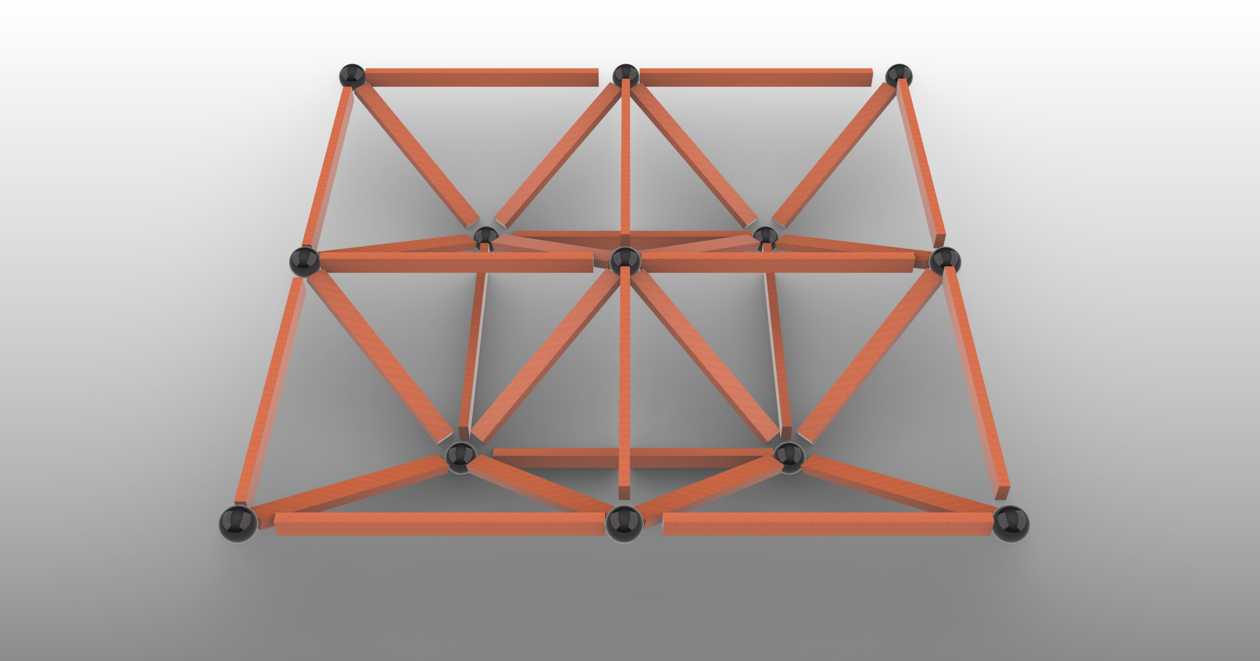
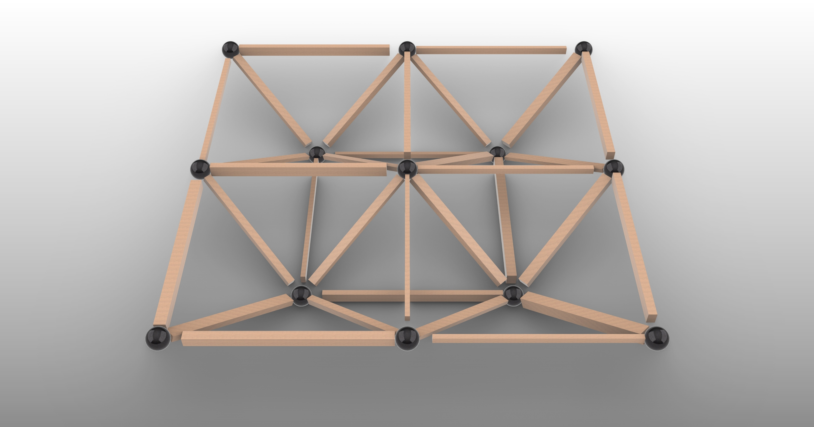
Recreating the original structure
Original
New wood
Reused wood

Slide 26
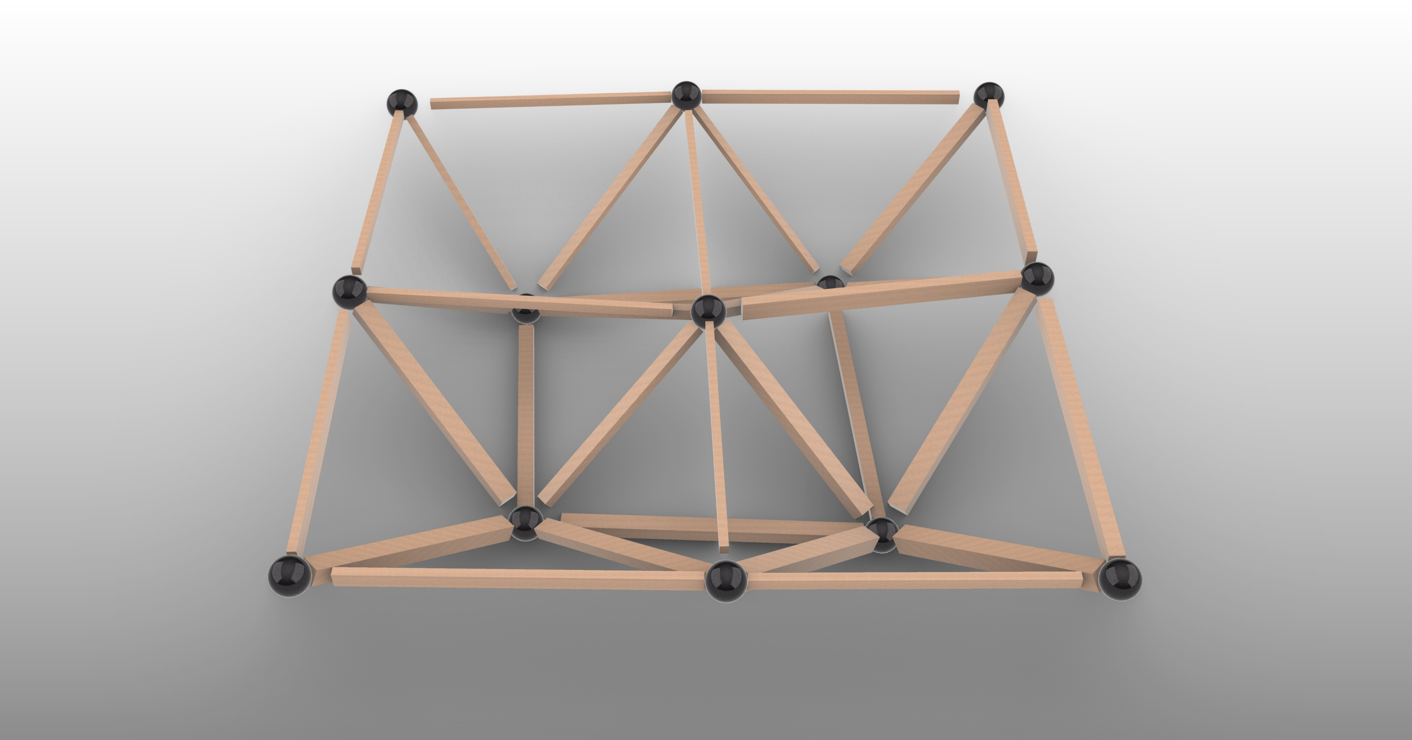
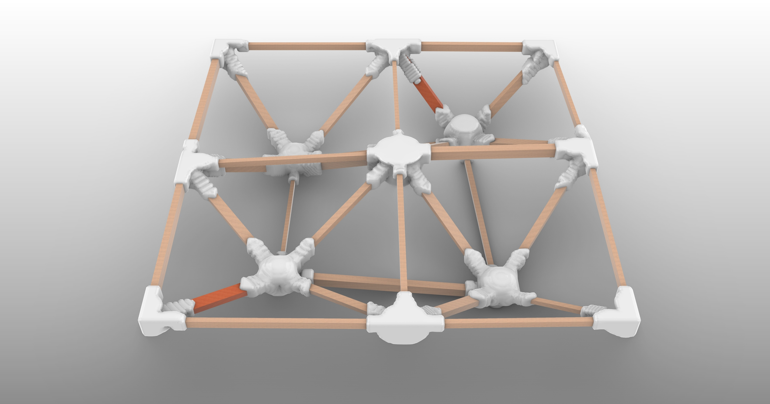
Creating freedom of motion
Optimized design
Optimized connections

Slide 27
Reuse optimizations
Element >= element required
No stock-constrained optimization
With saw-off losses
Element >= element required
With stock-constrained optimization
With saw-off losses
Element <= element required
with stock-constrained optimization
Without saw-off losses
Reused wood
Optimized design
Optimized connections

Slide 28
Creating the printable box
What goes into the connection?
Angles, profiles, position etc.

Slide 29
Loads and materials

Slide 30
Loads and materials
Material properties:
Density
Youngs modulus
Poisson ratio
https://encrypted-tbn1.gstatic.com/images?q=tbn:ANd9GcSzZsLJse_5FgLFHTOW3mvdlX8zKNwt1QMERN81_ArgzWGVJR25

Slide 31
Predefined settings

Slide 32
Generating the connections

Slide 33
The first result
Fast calculation time
Low resolution
65.176 cm3

Slide 34
Higher resolution
Slow calculation time
High resolution
-54% volume
29.781 cm3

Slide 35
Higher iso-value
Takes away “underutilized material”
-67% volume
21.438 cm3

Slide 36
Smoothening surface
Turning pixels into an surface
-74% volume
16.673 cm3
>
New surface
Old surface

Slide 37
The waste and LCA results
https://encrypted-tbn3.gstatic.com/images?q=tbn:ANd9GcSsi6Gw9_bk6TpXALxDeBsw3UhJFag9pE-05q5rSRBoMADt6-Uj

Slide 38
Waste production results

Slide 39
The LCA results

Slide 40
What happend?
https://encrypted-tbn3.gstatic.com/images?q=tbn:ANd9GcS7o5DeFLZlv9P7JNIvlaAqAvFkXtTIzXt0KLjjl1q4HJXLrKv_

Slide 41
How is this possible?
177 kg plastic
49 kg steel connections
Volume increase 25x
PETG
Steel

Slide 42
Conclusion
The question
My answer
“Can stock-constrained digital design combined with 3D printing support the reuse of wooden structural elements without saw-off losses in a sustainable way?”
Yes, it is possible to use this method and design with zero waste
However, it might not always be the most sustainable option when compared to the alternatives

Slide 43
Discussion
Structural validation of the connections
Topos is limited for detailed work

Slide 44
Discussion
A working attachment that survives the simulation
Attachment could be optimized to save material

Slide 45
Discussion
Scale was limited during the research

Slide 46
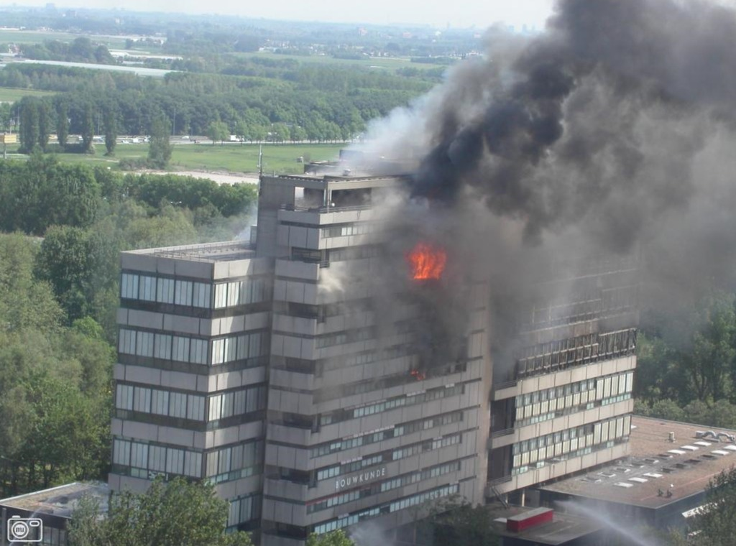
Discussion
Fire safety
Unthreaded wood + plastic connections
https://encrypted-tbn0.gstatic.com/images?q=tbn:ANd9GcReQOmKLDCkklg_0-Htpmqauy8e6xQc0IsyrMUvzLUXlhAgjHSf
https://vimeo.com/654116098

Slide 47
Oportunities
Different materials could lead to a more sustainable product
https://encrypted-tbn1.gstatic.com/images?q=tbn:ANd9GcSzZsLJse_5FgLFHTOW3mvdlX8zKNwt1QMERN81_ArgzWGVJR25

Slide 48
Oportunities
More materials become available to designers with the help of the developed tool
The supplies can come from more local places
https://encrypted-tbn0.gstatic.com/images?q=tbn:ANd9GcTZwYWrrfb0sGKMYt0QLIg65a1mBSvS33t8uacb3xyIMek6b4Sy

Slide 49
Oportunities
Only energy goes into the created stream
If the energy is CO2 neutral, so is the product
https://encrypted-tbn3.gstatic.com/images?q=tbn:ANd9GcQt2tP1CjfXCJEtVc9YcuILBk0FTOljrHCGuvfJaijU0Fzj5wXi

Slide 50
Reflection
Easy to compare strategies in a early design stage
Results might change in the future with new materials and different energy sources

Slide 51
Thank you

