Slide 1
Facilitor instructions Initiation Toolkit for value-based care living labs
Philips Design

Slide 2
When to use?
Before this toolkit can be used the type of lab and topics should be set. This toolkit is useful in follow-up conversations of the initiation phase of a living lab that aims for transformation to value-based care.
The toolkit contains three tools:
1) Identify the purpose
2) Find partners
3) Define objectives
No tools do exist yet for topic selection and tdefining the type of lab, in future situations these tools can be developed.
Besides, the toolkit can be extended in use during the start-up a living lab.
Tools in this toolkit
Tools that are not existing yet

Slide 3
Facilitator role
The facilitator has an important role in the use of this toolkit. This role is ideally executed by one person from Philips design that has the capabilities to facilitate co-creation session and visualize in Adobe programs.
The role includes responsibilities before, during and after sessions.
Before
Prepare the materials
Set-up meeting dates, invites and arrange location
During
Facilitate discussions and brainstorms
Keep track of time
After
Organize created materials and document outcomes and decisions
Visualize outcomes of sessions

Slide 4
How to use this slidedeck
Italic text in this booklet is ment for the facilitator only
Text in regular, or with “brackets” needs to be explained by the facilitator
Actions for facilitator during the sessions
Action for the participants: a questions or assignment for the group
Materials of the toolkit that are needed in this step are mentioned in grey
Elements with a box around it are directing to elements of the main slidedeck

Slide 5
Content main slidedeck
This instructions help to use and present the main slidedeck. This is the overview of elements in the main slidedeck, this overview is also included in the main slidedeck.
You can customize the elements you need for your situation (for example only use tool 1)
In the ppt the slides are clickable and direct you to the corresponding slide immediately
Background
Slide 3-6
Background
Slide 3-6
Background
Slide 3-6
Suggested next steps
Slide 41-44
Background
Slide 3-6
Background
Slide 3-6
Tool 1.
Purpose
Slide 7-21
Background
Slide 3-6
Background
Slide 3-6
Tool 2.
Partners
Slide 22-28
Background
Slide 3-6
Background
Slide 3-6
Tool 3.
Objectives
Slide 30-40
Background
Slide 3-6
Background
Slide 3-6
Use the indicators at the top of the slides to track progress.
Global issue
Brainstorm
Prioritize
Research
Define
Visualise
Iterate
1
2
3
4
5
6
7

Slide 6
Background
Good to know before using the tools

Slide 7
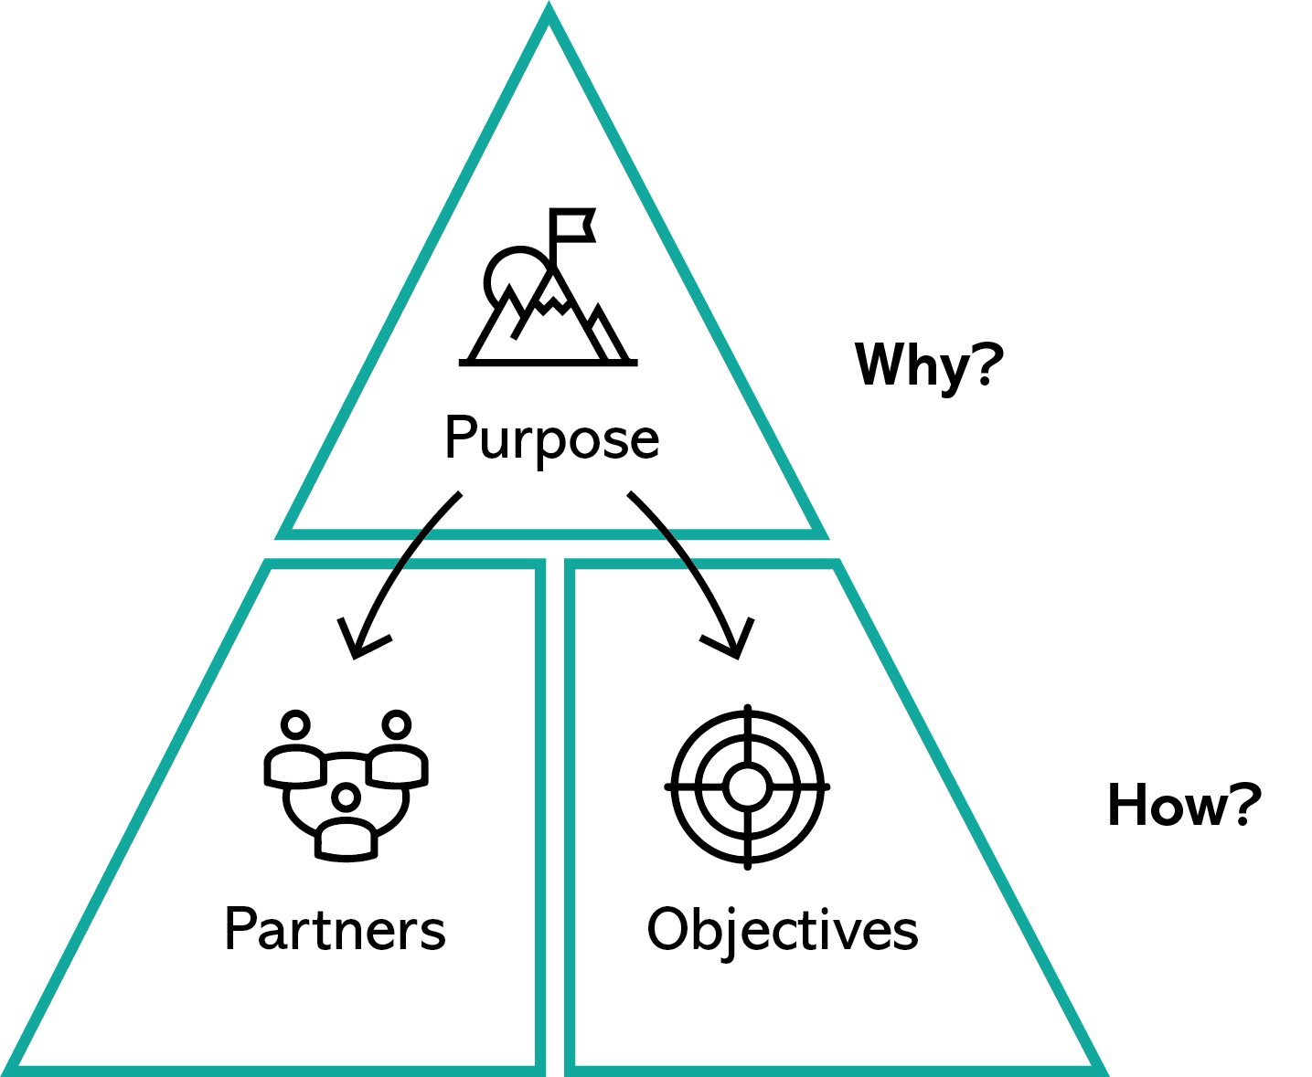
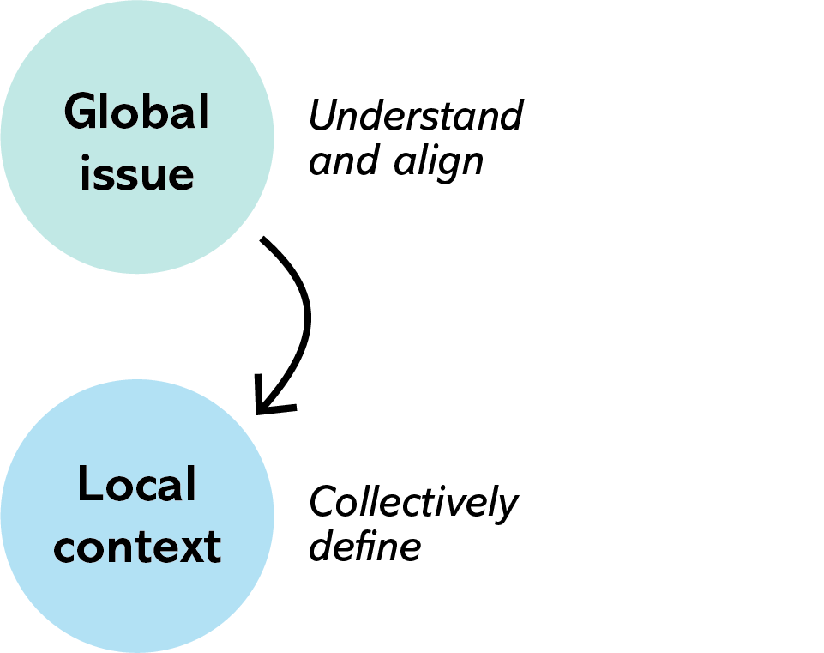
Background – structure
Suggestud to start with defining the purpose (tool 1) because this underlines the ‘why’.
Based on the purpose partners (tool 2) and objectives (tool 3) can be discussed, to move the discussion towards ‘how’ to achieve the purpose. There is no specific order in which partners and objectives tools need to be used.
The transformation to value-based care is a global issue. Existing theory is general needs to be made context-specific.
In the tools, the global issue is addressed first, with the goal to understand and align on the issue. Next step is to make the global issue context specific and define what this means in a local setting.

Slide 8
Tool 1. Define purpose
7 steps to a local purpose visualization

Slide 9
Preparation
Actions
Prepare the dates and meetings and change dates in main slide deck (slide 7)
Invite attendents
Reserve a room with whiteboard/flipover and projector/screen
Make sure people reserve time to conduct research between session 1 and 2
Materials
Print sheets on preferably A2 (purpose sheet nr 1, 2, 3, 4 & 5)
Bring post its and pens in different colours

Slide 10
During the meeting
Set-up all posters and the presentation in the room.
Start with a welcome and round of introduction if people are new to each other.
Explain the planning for this and for the next sessions, (adapt and use the slide below).
Session 1
Global issue
Brainstorm
Prioritize
Research
Session 2
Define
Visualise
Session 3
Iterate
1
2
3
4
5
6
7
Date:
Attendents:
Date:
Attendents:
Date:
Attendents:
Reserve time to conduct individual research between
(date) and (date)

Slide 11
Global issue
Brainstorm
Prioritize
Research
Define
Visualise
Iterate
1
2
3
4
5
6
7
Purpose sheet 1
Go through the global visualization poster
“The toolkit is structured in a global – local way”, (this is mentioned in the background section already).
“First we are going to look at the global level of the issue, next we are going to define what we are going to do is the local setting. We are going to use the global issue as inspiration for defining our local issue.”
“Global issue is build up from challenge, vision and enablers, I will take you through them step by step.”
Next slide
“Globally we see systemic challenges”. (Name some elements of the visual you see on the slide, for example: staff burnout, rising costs)
“The challenges appear in four categories: patient satisfaction, staff satisfaction, healht ouctomes and rising costs.”
“These four categories show that the challenges within the current situation are systemic challenges. Therefore the system should be addressed.”
“The quadruple aim is a suitable framework to address the challenges. This leads to the following vision: value-based care addressed by the quadruple aim.”

Slide 12
Global issue
Brainstorm
Prioritize
Research
Define
Visualise
Iterate
1
2
3
4
5
6
7
Purpose sheet 1
Next slide
“This shows the ideal situation for a health system”
Mention the four elements of the quadruple aim.
Next slide
“Micheal Porter, the international health organization and Philips have published studies about how to realize this transformation. It appears that five enablers are key in transforming to value based care. Those are …” (five enablers shown in slide)
Next slide
Discuss understanding
Is something in the overview unclear?
Who does agree on using the quadruple aim as a framework to guide the transformation? (hands up)

Slide 13
Global issue
Brainstorm
Prioritize
Research
Define
Visualise
Iterate
1
2
3
4
5
6
7
Purpose sheet 2
Highlight which challenges in the global issue we recognize
Go to sheet 2, hand out post its if not on table yet
Which of the global challenges do we recognize?
Highlight the ones on the paper that are mentioned and agreed
If people bring up ideas, explain they have to write it down on post its
Brainstorm on local challenges
Take 2 minutes to write down your ideas and examples in the highlighted areas
Give a few examples of local challenges
Organize challenges on a map
Next slide
“We are going to categorize the ideas in 2 areas: systemic and non-systemic challeges.”
“The challenges that are systemic challenges often affect multiple stakeholders and addresses the socio-technical system. This means that not only a product or one service is part of the concern, but a bigger system around it.”
Can everyone stand up, come to the sheet and bring their post its?
Organize the challenges on the quadruple aim and place it in one of the circles.
Check if it is relevant to cluster multiple challenges into a bigger challenge

Slide 14
Global issue
Brainstorm
Prioritize
Research
Define
Visualise
Iterate
1
2
3
4
5
6
7
Purpose sheet 3
Prioritize challenges on impact and ability to act
Bring sheet 3
Explain axis that appear in slide “Impact: How much value does it have if we solve this challenge. Ability to act: Can we together act upon the challenge(s)”
Take the post its from the old map (systemic circle) and stick on the priotization map
Place it on a place you think is good and ask if someone disagrees. If someone disagrees go into a small discussion and position it on the right place.
We now have to select a number of challenges from the upper right corner that we see of value to pursue in this lab.
Check if the challenges together are a good match
Take a selection from the upper right corner and ask if others agree
Take the post its and put them on the next sheet (4)

Slide 15
Global issue
Brainstorm
Prioritize
Research
Define
Visualise
Iterate
1
2
3
4
5
6
7
Purpose sheet 4
Map out what we do already know and what we don’t know
Know we are going to find more in depth information of the challenges we selected
Write on post its with green colour: What do we already know about the challenges?
Write orange post its: What information is crucial but missing?
Define who is going to do additional research
To make this overview complete we need to get a better understanding on the orange topics. We are going to find out more in between this session and next.
Doing research could be: internal data on outcomes, external data, insights based on conversations, survey outcomes, customer journey maps.
Create a table on white board or flip over and take the red/orange post its
Create columns: 1) topic 2) who is going to do research 3) how?
Fill in the table and direct responsibilities
Repeat that it needs to be finished at the deadline as discussed before.

Slide 16
Global issue
Brainstorm
Prioritize
Research
Define
Visualise
Iterate
1
2
3
4
5
6
7
Purpose sheet 4
Conduct individual research
Bring up back the challenge sheet (4) from last time & explain what the agenda is for today
Ask attendents to present the facts and insights from individual research to each other
Complete the map of challenges & insights and remove missing parts/improve wrong ones
Important to archive the research done and insights gained, make the outcomes findable for future situations

Slide 17
Global issue
Brainstorm
Prioritize
Research
Define
Visualise
Iterate
1
2
3
4
5
6
7
Purpose sheet 5
Map the challenge, vision and enablers
Take the outcomes from sheet 4 and place them on sheet 5.
Now we know the challenge, we will move to the vision. Stay visionary, it is about the ideal situation.
Come up with a vision statement for each challenge, what is it that we want to realize?
For inspiration, you could look at the global issue and see if elements are relevant for now
Write down vision aspects on post its and paste them on sheet 5
Discuss the five enablers of the global issue.
Order the five enablers on importance and write them down on sheet 5.
If arguments are mentioned that are considered relevant to store on the poster as well, write them down.

Slide 18
Global issue
Brainstorm
Prioritize
Research
Define
Visualise
Iterate
1
2
3
4
5
6
7
Digital visualization of the local issue
Worksheet 5 is going to be the basis for the visualization of the local issue
The style will look like the global poster, if possible.
The visualization will be done by (some from Philips).
The poster will be going through one round of feedback.
Visualize the poster in Photoshop

Slide 19
Global issue
Brainstorm
Prioritize
Research
Define
Visualise
Iterate
1
2
3
4
5
6
7
First visualization
Suggest improvements
Print the visualization and bring it to the next session
Ask for suggestions for improvement
Write down remarks on the poster
Verify that if the changes are executed, the poster will be final
Final visualization
Update the visualization
Print the visualization and hang it at a visible place
Note: this session can be combined with a first session for partners/objectives
Final visualization

Slide 20
Tool 2. Identify partners
5 steps to understand the partner ecosystem

Slide 21
Preparation
Actions
Prepare the dates and meetings, invite attendents are reserve a room with whiteboard/flipover and projector/screen
Materials
Local purpose visualization from tool 1
Print partner sheets on preferably A2 (nr. 1, 2)
Bring post its and pens in different colours
Preferably a room with a whiteboard, else a flipover

Slide 22
During the meeting
Set-up all posters and the presentation in the room.
Explain the planning for this and for the next sessions (adapt and use the slide below).
Session 1
Identify stakeholders
Draw
Relations
Categorization
Checklist
Visualise
1
2
3
4
5
Date:
Attendents:

Slide 23
Identify stakeholders
Draw
Relations
Categorization
Checklist
Visualise
1
2
3
4
5
Partner sheet 1
Whiteboard
Take one of vision elements as a starting point
The vision probably consists of several aspects. Propose to start with the element that is seen as most important.
Explain the other aspects will be covered later.
Write down the aspect on a whiteboard
Ideate who is needed to realize the vision
We will try to understand mechanism behind this vision. Therefore we want to identify first which stakeholders are influencing the goal.
Who do you think are important enablers or influencers of this goal?
Write down the stakeholders that are mentioned and within a circle leave enough space between. Example:

Slide 24
Identify stakeholders
Draw
Relations
Categorization
Checklist
Visualise
1
2
3
4
5
Whiteboard
Draw relationships between stakeholders
Now the goal is task is to define the interactions between the stakeholders. We need to draw lines between the stakeholders and shows how the vision can be realized.
Next slide, explain the example of how this can work
Ask which relations they see
Draw the relations between the stakeholders
Repeat for other goals
Start with another vision element and create a stakeholder map for this goal. If stakeholders are similar, and it fits in the existing structure, continue with that. If it is too messy or full, start a new one and combine them later on.
If you choose to add to the existing one take another marker colour, in order to keep the different vision aspects seperate. (example below)
If the number of maps and arrows becomes too much, it is needed to prioritize relations. Highlight the arrows that need most attention.

Slide 25
Identify stakeholders
Draw
Relations
Categorization
Checklist
Visualise
1
2
3
4
5
Whiteboard
Partner sheet 2
Divide the stakeholders in 3 groups
Now we need to considered which of those stakeholders are important to collaborate with. We could or collaborate on lab level, or only on project level.
Lab partners are probably involved in multiple elements of the vision. You could see as different coloured arrows connected to this stakeholder.
Project partners are probably involved in only one of the elements of the vision.
If one of the stakeholders on the board is considered not that important, we could also group it under ‘other stakeholders’.
Use post its with different colour to mark which stakeholders are in which groups. (for example green for lab stakeholders and yellow for project stakeholders). Do suggestions for the roles of each of the stakeholders yourself and ask for feedback from other participants.
If every stakeholder is marked with a colour and everyone agrees, draw lines around the group of partners considered in each category.

Slide 26
Identify stakeholders
Draw
Relations
Categorization
Checklist
Visualise
1
2
3
4
5
Partner sheet 2
Check if the ecosystem is sufficient and sustainable
Are all lab partners benefiting in the current system?
Can we together realize our vision?
Do we have the data required?
Do we have the capability to scale up successful interventions?
Check on those criteria and improve the stakeholder map if required

Slide 27
Identify stakeholders
Draw
Relations
Categorization
Checklist
Visualise
1
2
3
4
5
Partner sheet 2
From whiteboard to paper
During the session: map the whiteboard version on paper in a neat way.
For later use, make the paper version also digital

Slide 28
Tool 3. Set objectives
5 steps to specify objectives and outcome measures

Slide 29
Preparation
Actions
Prepare the dates and meetings, invite attendents are reserve a room with whiteboard/flipover and projector/screen
Edit worksheet 2 in Photoshop/Indesign and include the outcomes of tool 1 in the placeholders of the work sheet. This also needs to be inserted in the main slidedeck.
Materials
Print sheets on preferably A2 (Objectives sheet nr. 1, 2)
Bring post its and pens in different colours

Slide 30
During the meeting
Set-up all posters and the presentation in the room.
Explain the planning for this and for the next sessions (adapt and use the slide below).
Session 1
Outcome
measures
Inspire
Objectives
Check
Visualise
1
2
3
4
5
Date:
Attendents:

Slide 31
Outcome
measures
Inspire
Objectives
Check
Visualise
1
2
3
4
5
Objectives sheet 1
Objectives sheet 2
Inspire
Show objectives sheet 2, and reflect on the vision aspects from tool 1.
In this session the vision will be made more specific, so we are going to ask ourselves ‘how’ questions. How is this going to be realized? How is this going to be measured?
What helps us to define objectives in line with the quadruple aim is the inspiration sheet (objectives sheet 1). In this overview we see how we should understand and use the quadruple aim.
With the local vision and the quadruple aim inspiration sheet in our mind, we are going to barinstorm on obejctives.

Slide 32
Outcome
measures
Inspire
Objectives
Check
Visualise
1
2
3
4
5
Objectives sheet 1
Objectives sheet 2
Define SMART objectives
Explain the concept of smart objectives.
Give some examples of a vision and linked objectives
Vision: Better patient experience for elderly people
→ Objective: Zero complaints from patients in 2025
Vision: Less administrative burden physicians
→ Objective: Time spend on administration reduced with 25%
Write down possible objectives individually (2 min)
Move to objectives sheet 2 and paste objectives in the overview.
If too many objectives have been written down, limit to 1 or 2 per aspect of the vision that fit best with the vision.
S Specific
M Measurable
A Achievable
R Realistic
T Time bound

Slide 33
Outcome
measures
Inspire
Objectives
Check
Visualise
1
2
3
4
5
Objectives sheet 1
Objectives sheet 2
Define outcome measures for the identified objectives
The first circle of sheet 2 needs to be filled with good objectives.
How these objectives can be measured?
Write down the answers on postits
Continue till a balanced set of objectives and outcome measures is obtained
Checklist objectives and outcome measures
Do a final check on the objectives and measures and check if everyone agrees with this set.
Are the objectives SMART?
Is the outcomes measure in line with the transformation?
Can we measure this outcome? (or do we need an additional partner)
Visualize
Visualize the outcome of the session, make it digital, and use it for future steps.

Slide 34
Suggested next steps
After tool 2 and 3

Slide 35
Suggested next steps
After having mapped the ecosystem (tool 2):
Approach new partners and convince
Onboard new partners
Discuss roles & responsibilities of partners
Define organizational structures (for example steering)
After having defined objectives (tool 3):
Define projects
Which objectives are addressed in which projects?
Who need to be involved in which project?
Determine status at moment zero
Create dashboard to track progress
Determine how and how often progress is going to be evaluated

