Slide 1
Immiscible N2 Injection for EOR: An Experimental Comparison Study
Drs. Fardin Azimi*, Drs. Martijn Janssen* and Prof. Dr. Pacelli Zitha*
* TU Delft, The Netherlands
Notes:
Good day to you all,
My name is Martijn Janssen and I am a PhD student of Prof Zitha at the Technical University of Delft, The Netherlands.
Today I will present the work I did together with my MSc student last year: Fardin Azimi → “Immiscible N2 injection for EOR: An Experimental Comparison Study”.

Slide 2
Content
Introduction
Materials and Methods
Results and Discussion
Conclusions and Recommendations
Notes:
First the content of this presentation

Slide 3
Introduction
Research objective
Assess several immiscible nitrogen injection schemes in order to shed light on their underlying displacement mechanisms.
Hypothesis
Oil swelling and viscosity reduction negligible → have to look for an additional displacement mechanism:
N2 flood: “oil spreading and film flow”
Requires high spreading coefficient S = σwg – σog – σow
WAG: part of free gas present in core becomes trapped during water injection → reduces krg and krw → improving mobility ratio
Notes:
Research objective ➔ “Assess several immiscible nitrogen injection schemes in order to shed light on their underlying displacement mechanisms.”
N2 injection schemes:
Primary N2 flooding (N2 injection at initial oil saturation) at different back-pressures
Secondary N2 flooding (WF followed by N2 flooding)
Water-Alternating-Gas (WAG)
Hypothesis ➔
- if the pressure is low (lower than 30 bar), solubility of N2 is negligible.
- N2 has relatively high MMP (>300 bar in our case based on correlation from Sebastian and Lawrence) and it does not dissolve in oil very easily
➔Oil swelling and oil viscosity reduction negligible
➔Need to look for additional displacement mechanism
Hypothesis 1 for immiscible N2 flooding: Film flow
Film flow ➔ gebeurt alleen als water – gas IFT relatief high is tov oil – gas, oil – water IFT. Oil spreidt zich uit over dit interface (gas-water interface) en kan zo geproduceerd worden. ➔ een potentieel displacement mechanisme van immiscible N2 injection.
Hypothesis 2 for WAG: 3-phase relative permeability effect
Potential displacement mechanism. Trapped gas saturation neemt toe, totale gas saturation neemt toe, Krg neemt af, Krw neemt ook af omdat gas saturation toeneemt → improves mobility ratio and thus reduces Sor.
(CO2 flood vs. CO2+N2 flood ➔ when N2 was added it showed higher recoveries then only pure CO2 → other displacement mechanisms than oil swelling and viscosity reduction should be responsible for the improved oil recovery ➔ build-up of a free gas saturation, this may reduce the relative permeability to water, this improves the mobility ratio.
WAG ➔ flowing gas saturation decreases and trapped gas saturation increases → gas rel perm decreases → more favourable gas – oil mobility ratio : more stable oil displacement by gas. The more cycles → the higher the trapped gas saturation which most likely results in lower oil saturation.)

Slide 4
Oil spreading and film flow in gravity stable conditions
Water
High Spreading Coefficient causes
oil to spread on water surface
Larger throat
Oil
Smaller throat
Gas
Vertical distance (H) from gas front is sufficient → gas may enter the pore throat and oil can drain from the corners.
Capillary continuity is required for oil films to exist.
Pore throat might be too small → highly curved gas – oil interface may terminate the film flow → residual oil.
Residual oil
Khorshidian, H., James, L.A. and Butt, S.D. 2016: The Role of Film Flow and Wettability in Immiscible Assisted Gravity Drainage.
International Symposium of the Society of Core Analysts, Colorado, USA.
Notes:
In this slide I want to focus a bit more on the “film flow” phenomena.
Situation sketch: This is a water-wet system where we inject gas at a fully oil saturated core at Swc, the core is placed vertically → gravity stable conditions. By Khorshidan, James and Butt (2016).
Fig 1➔
We have a pore together with two pore throat (a larger and a smaller one). Blue = water. Red = oil. Green = gas. Gas is injected from the top.
Fig 2➔
Gas has entered the pore body and once the vertical distance between the gas front and the pore throat is sufficient (H), then the capillary pressure is high enough for gas to enter the pore through the center of its throat ➔ Pcgo = Pcgo_front + Δ𝜌𝑔𝐻
Fig 3➔
Now oil can be drained out from the throat corners as oil can spread on the water – gas interface (if spreading coefficient is high enough)!!
Note: Capillary continuity is required for oil films to exist. Liquid films can rupture when Pc exceeds ciritcal Pc !!
Note: If the pore throat is too small then the oil film elevation can be terminated since the oil – gas interface might be to highly curved ➔ residual oil exist in smaller pores.

Slide 5
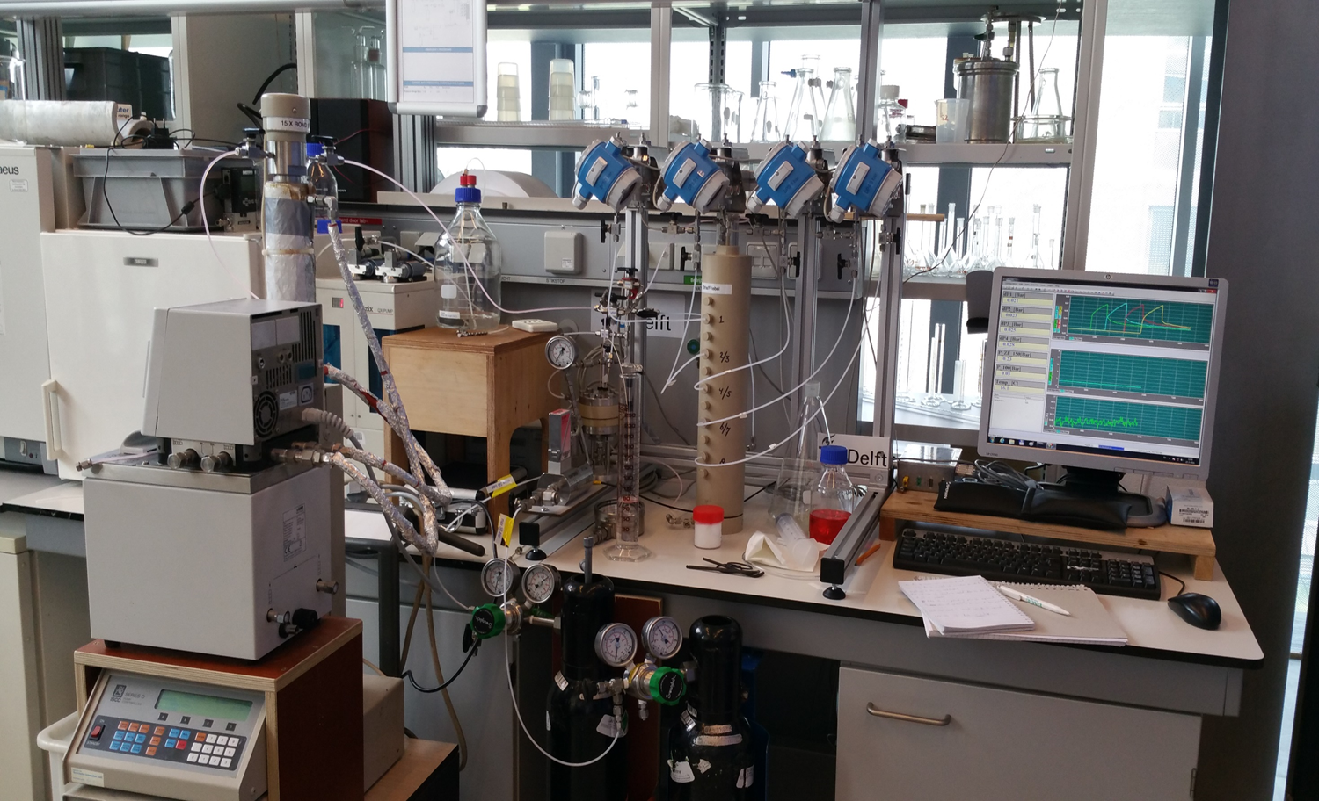
Experiments
Notes:
I’ve explained the research objective ➔
Now lets continue with the experimental work.

Slide 6
Materials and Methods
Chemicals
Core sample
Initial Brine: 3wt% NaCl
Dopant: Potassium Iodide
Oil: n-Hexadecane
Dopant: 1-Iododecane
Gas: N2
Bentheimer sandstone
Properties of porous media used in the experiments.
Experiment # → | 1 | 2 | 3 | 4 | 5
Porosity (%) | 24.00 ± 0.10 | 24.00 ± 0.10 | 23.00 ± 0.10 | 23.00 ± 0.10 | 24.00 ± 0.10
Permeability (Darcy) | 2.88 ± 0.10 | 2.96 ± 0.10 | 2.68 ± 0.10 | 1.94 ± 0.10 | 2.30 ± 0.10
Length (cm) | 40.00 ± 0.10 | 40.00 ± 0.10 | 17.00 ± 0.10 | 17.00 ± 0.10 | 17.00 ± 0.10
Diameter (cm) | 3.90 ± 0.10 | 3.90 ± 0.10 | 3.90 ± 0.10 | 3.90 ± 0.10 | 3.90 ± 0.10
Pore volume (cm³) | 114.68 ± 6.70 | 114.68 ± 6.70 | 46.71 ± 3.00 | 46.71 ± 3.00 | 48.74 ± 3.00
Notes:
This slide presents the materials and methods section.
Chemicals:
As initial brine we used 3 wt% sodium chloride dissolved in degassed demi water
As model oil we used normal hexadecane
The gas we used for gas flooding is nitrogen gas with a purity of more than 99%.
In some of the experiments we have doped the oil and water phase to enhance its density differences for visualization purposes on CT-scan images. (the density difference between the oil and water phase should sufficient enough to distinguish the two phases).
Core sample
In all core-flood tests Bentheimer sandstone samples have been used (40 and 17 cm length → 17 cm length because 40 cm didn’t fit vertically in CT). Its properties per experiment are shown in the following table.
In total we performed 5 tests
Porosity is around 23/24 %
Perm varies between 2 and 3 darcy

Slide 7
Materials and Methods
Experimental procedure: overview of core-flood tests
Overview of core-flood tests conducted
Experiment | EOR process | Gas injection rate (cm³/min) | Water injection rate (cm³/min) | WAG ratio (volume water – volume gas) | Back pressure (bar) | CT assisted
1 | GF | 0.5 | - | - | 5, 10, 20, 40 and 60 | No
2 | GF | 0.5 | - | - | 5 | No
3 | GF | 0.5 | - | - | 10 | No
4 | WF* + GF | 0.5 | 2.0 | - | 5 | Yes
5 | WAG* | 0.5 | 2.0 | 1:6 | 5 | Yes
*Brine has been used for water flooding.
The core was placed vertically in all experiments to ensure gravity stable conditions.
Notes:
This slide shows an overview of the 5 different core-flood tests that have been conducted in this work:
1,2 and 3 ➔ Primary gas flooding at fully oil saturated core at Swc. 1=back-pressure is varied during gas flooding once steady state P conditions were observed
2= BP=5
3= BP=10
4= WF followed by gas flooding at BP of 5 bar
5= Water-Alternating-Gas flooding using WAG ratio of 1:6 (very dry) with BP of 5 bar.
CT scans were taken during last 2 experiments.
Core placed vertically
WAG → 1.8 PV gas and 0.3 PV water!!!!!

Slide 8
Materials and Methods
Experimental procedure: overview of sequence used
Sequence used to perform the core-flood experiments.
Step | Experiment | Description | Back pressure (bar) | Flow rate (cm³/min) | Injection Pressure (bar) | Flow direction
1 | 1,2,3,4 and 5 | CO2 flushing | - | - | 5 | Down
2 | 1,2,3,4 and 5 | Brine saturation (3 wt% NaCl) | 25 | 2.0 | - | Up
3 | 1,2,3,4 and 5 | Oil injection | 0 | 2.0 | - | Down
4 | 4 | Water flooding (3 wt% NaCl) | 0 | 2.0 | - | Up
5 | 1,2,3 and 4 | Gas flooding | Test 1: 5, 10, 20, 40 and 60 Test 2 and 4: 5 Test 3: 10 | 0.5 | - | Down
6 | 5 | WAG injection | 5 | Gas: 0.5 Water: 2.0 | - | Down
Notes:
This slide presents an overview of the sequence used for every experiment.
The first three steps are the same for every experiment:
1- CO2 flushing to remove all air inside core
2- Brine injection at 25 bar BP to ensure complete dissolution of CO2 in water → permeability determination by varying flowrate.
3- Primary drainage in order to establish oil saturation at Swc
Note: gas and oil are injected from the top and water from the bottom = ensuring gravity stable conditions.
Tests 1,2,3 ➔ next step is to conduct gas flooding.
Tests 4 ➔ Next step is to conduct WF and subsequently GF
Test 5 ➔ next step is to conduct WAG flooding.

Slide 9
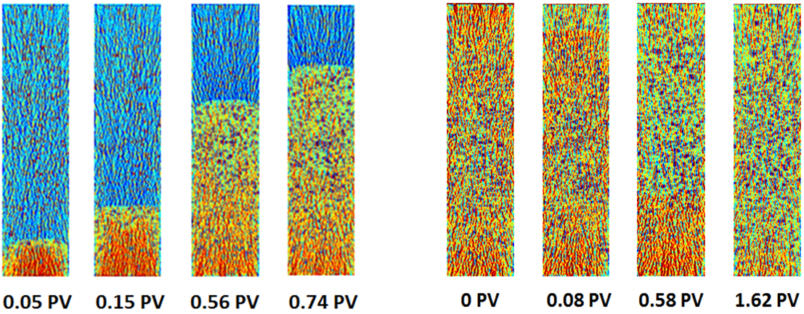
Results and Discussion
Results prior to gas injection
Experiment # → | 1 | 2 | 3 | 4 | 5
S_{wc} | 0.22 ± 0.02 | 0.21 ± 0.02 | 0.30 ± 0.02 | 0.24 ± 0.02 | 0.26 ± 0.02
S_{oi} | 0.78 ± 0.02 | 0.79 ± 0.02 | 0.70 ± 0.02 | 0.76 ± 0.02 | 0.74 ± 0.02
S_{or_WF} | - | - | - | 0.49 ± 0.02 | -
RF_{_WF} (% of OIIP) | - | - | - | 0.36 ± 0.03 | -
k_{roe} | 0.53 ± 0.03 | 0.53 ± 0.03 | 0.48 ± 0.05 | 0.65 ± 0.07 | 0.60 ± 0.05
k_{rwe} | - | - | - | 0.14 ± 0.01 | -
Test 4: CT-scan images corresponding to brine injection and primary drainage.
Notes:
Now lets focus on the results:
This slide presents the results prior to gas flooding for all experiments conducted:
-Average Swc is around 0.23 with extremes of 0.21 and 0.30 → (test 3 differs, maybe due to lower porosity of the rock)
-RF WF is only present for test 4 since this is the only test where WF was performed → Sor_WF is quite high!! ➔ probably due to Pc-end effect (water accumulates at the core outlet preventing oil to come out)!!
Figure:
CT-scan images corresponding to experiment 4: brine saturation from the bottom (red=water and blue=gas). And Oil injection from the top (oil=groen-ish). Note the very stable displacement front in both processes!

Slide 10
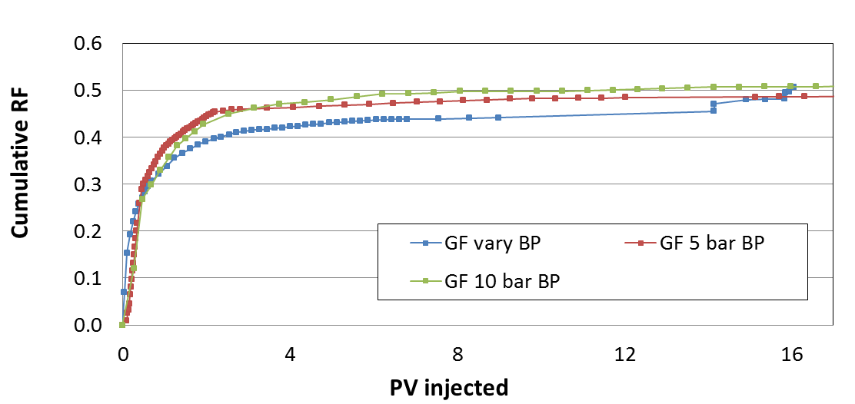
Results and Discussion
Tests 1, 2 and 3 – Primary N2 injection with different back-pressures
Recovery
Similar ultimate recovery factors (RF) → 51 ± 2 % of OIIP
Similar residual oil saturations (Sor) → 0.37 ± 0.03
Gas breakthrough → 0.47 ± 0.04 PV
Notes:
This slide presents the Cumulative Recovery factors for the first three experiments.
Blue= primary gas flooding varying BP → vanaf 14 PV inj → BP increased to 5, 10, 20, 40 and 60 bar. ➔ that’s why you see some jumps in the recovery factor plot. We didn’t expected this since the maximum BP was 60 bars and is still well below its MMP (~350 bar according to the correlation of Sebastian and Lawrence (1992)) → so the recovery mechanism is still the same, immiscible conditions. The reason may be that now conditions do approach MMP a bit more, the gas – oil IFT might be somewhat lowered, however small this is.
Red= primary gas flooding 5 bar BP
Green= primary gas flooding 10 bar BP

Slide 11
Tests 1, 2 and 3 – Ternary diagrams
GF 5 bar BP
GF vary BP
2
S_{or_}GF
1
N₂ flooding
Primary drainage
Primary drainage
GF 10 bar BP
Similar saturation paths
Swc is not effected by N2 flooding → it indicates a two – phase gas – oil flow
Similar Sor
3
S_{or_}GF
N₂ flooding
Primary drainage
Notes:
Since we are collecting the effluent every 10 min we can apply material balance calculations to obtain average saturations in the core → these saturations are then used to construct the following ternary diagrams (we know what we inject, what we produce and thus what remains in the core).
Tests 1-3 ➔
Similar saturation paths → Swc is not effected by N2 inj→ almost a straight linear paths → looks like two-phase gas-oil flow ➔ similar Sor.
Note: Swc can be lowered during N2 flooding as water can vaporize into the gas phase
Oil recovery by N2 has the distinctive feature of an immiscible displacement in that oil is produced during displacement of the gas front through the core

Slide 12
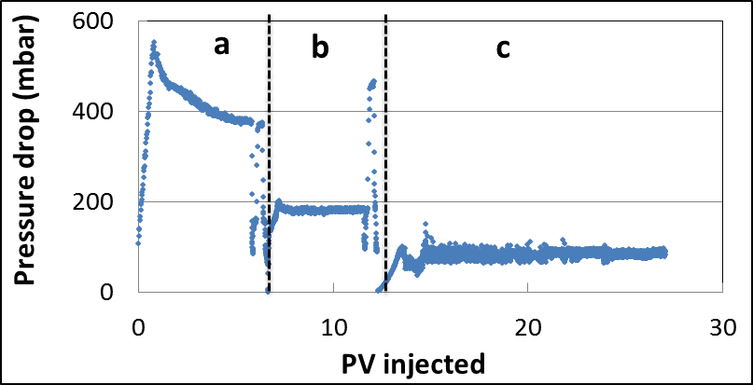
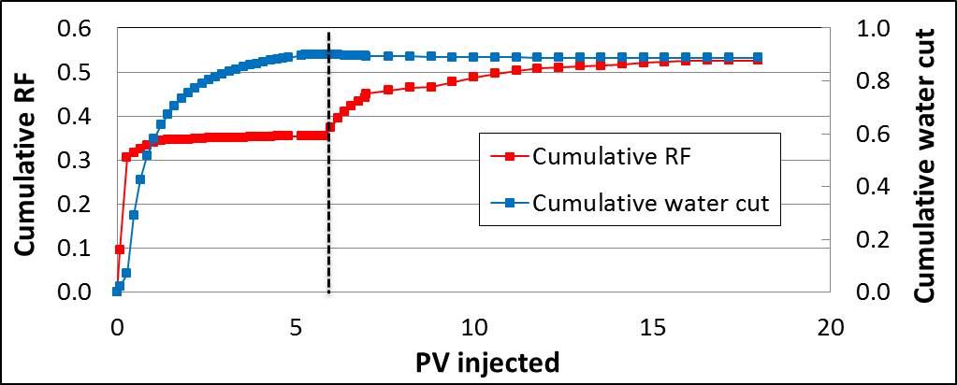
Results and Discussion
Test 4 – WF + N2 injection at 5 bar back-pressure
Total pressure drop
RF_WF = 35 %
Sor_WF = 0.49
RF_total = 53 %
Sor = 0.36
Recovery
Notes:
This slide presents the total pressure drop and cumulative oil recovery/water cut for test 4 ➔ WF followed by GF at 5 bar BP. (5 bar is chosen since this BP showed the highest oil recovery in the first three experiments).
Total Pdrop:
A = oil injection → Oil BT at ~ 0.7 PV, in the end flowrate variation to obtain Kroe=0.65.
B = water flooding → Water BT after ~0.3 PV water injection. in the end flowrate variation to obtain Krwe=0.14. Lower Pdrop due to difference in viscosities.
C = gas flooding. Gas BT after ~ 0.5 PV
Cumulative RF and water-cut:
RF WF = 35%
Sor_WF = 0.49 ➔ pretty high probz due to Pc end effect
After ~6 PV N2 flooding starts → leads to an ultimate RF of 53 %, Sor = 0.36.
➔ Watercut remains ~constant after water breakthrough.

Slide 13
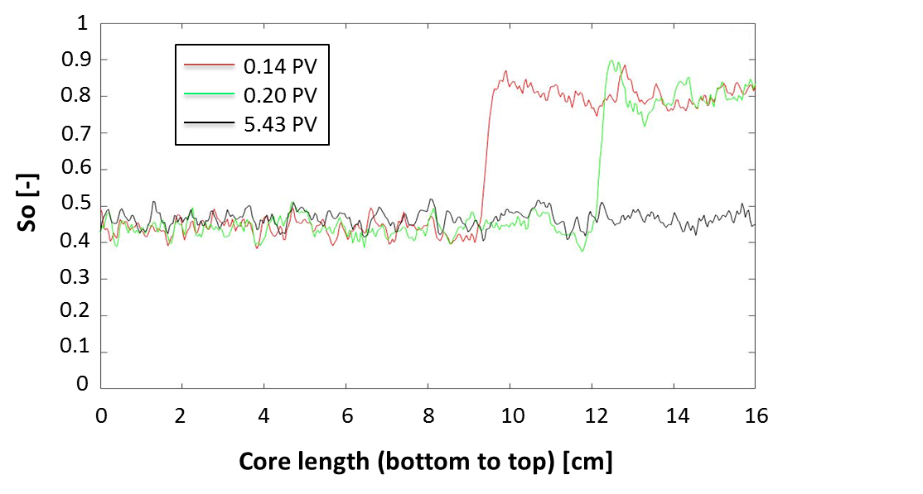
Results and Discussion
Test 4 – WF + N2 injection at 5 bar back-pressure
So profile during WF
$$S_{o}=\frac{(CT_{wo}−CT_{w})(1−S_{wc})}{CT_{swc}−CT_{w}}$$
Soi = 76 %
Sor_WF = 0.49
Water BT at 0.28 PV
Sharp front observed
Notes:
This slide presents the oil saturation profile determined during waterflooding in test 4. The following equation is used.. Where Ctwo = CT image during WF
CTw= CT image wet core CTswc = CT image at fully oil saturated core at Swc and Swc equals connate water saturation obtained from material balance.
The values are in good agreement with values obtained from material balance. We observe a sharp displacement front.
Note= CT images were not optimal as we placed the core vertically. We had a lot of cross-artefacts on our images since the medical CT is build for the human body (round objects), not for vertically placed sandstones……

Slide 14
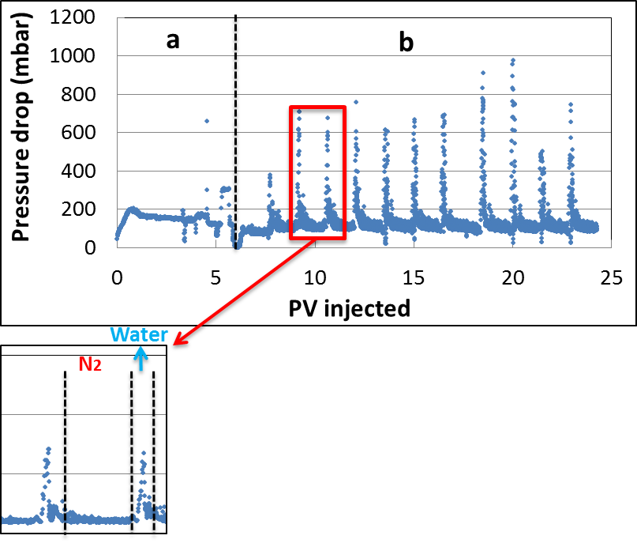
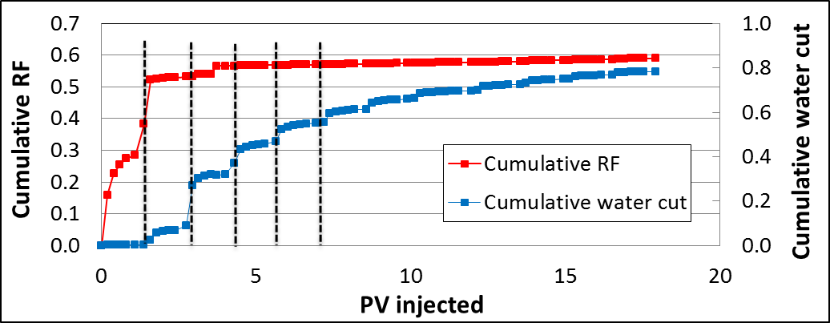
Results and Discussion
Test 5 – WAG at 5 bar back-pressure
12 cycles
Flowrate (cm³/min)
N2 → 0.5
Water → 2.0
Cycle starts with N2
RF = 59 %
Sor = 0.30
Total pressure drop
Recovery
Notes:
This slide presents the total pressure drop and cumulative oil recovery/water cut for test 5 ➔ WAG at 5 bar BP. (5 bar is chosen since this BP showed the highest oil recovery in the first three experiments).
Total Pdrop:
A = oil injection → Oil BT at ~ 0.7 PV, in the end flowrate variation to obtain Kroe=0.60.
B = WAG using a water-gas ratio of 1:6 (dry WAG scheme). As the test proceeded, brine injection in each cycle caused higher pressure drops, which is in good agreement with other studies, Dong et al (2005) [27]. This can be most likely explained by the fact that flowing gas saturation decreases and trapped gas saturation increases with the number of cycles leading to declining gas relative permeability (see section 2.2).
Total cycles: 12
Flowrate brine = 2 ml/min
Flowrate N2 = 0.5 ml/min ➔ explains the higher Pdrop for water injection stage (together with the higher viscosity of water compared to N2)
Recovery:
First three cycles contributed the most to the ultimate RF! Especially the end of the first cycle (small amount of water inj → steep increase in RF) →
1st cycle → RF N2= ~28% RF water= ~33%
2nd cycle → additional RF of ~20 %
3rd cycle → additional RF of 4 %.
After 3 cycles → 57%
Final after 12 cycles → 59 %, Sor = 0.3

Slide 15
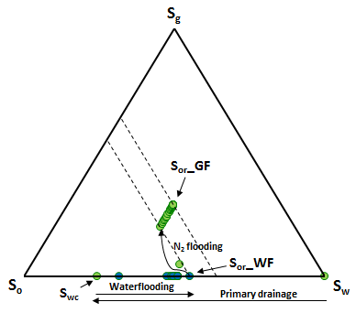
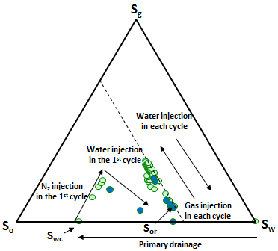
Tests 4 and 5 – Ternary diagrams
A
WF + GF
WAG
B
4
5
First two cycles contributed the most to the RF
Notes:
WF + GF ➔
Shock saturation was high because most of the recovery through water flooding (30.6 %) was achieved till water breakthrough. The increase in recovery factor after water breakthrough was limited (4.9 %). The reason for this can be the capillary end effects as zero capillary pressure at the outlet causes water saturation to be very close to 1−𝑆𝑜𝑟 resulting in trapping of the oil. The following N2 injection caused a high recovery of 17.1 % which clearly indicates that residual oil saturation for gas flooding under three-phase flow conditions is lower than that under two-phase flow.
WAG ➔
The interpretation mentioned above for Test 4 regarding that 𝑆𝑜𝑟 is lower under the three-phase conditions compared to that in two-phase flow is also valid for WAG and is supported by the results (see Table 7). Saturation path for WAG is illustrated in Figure 25 with water injections colored blue. Corresponding to Figure 18, it is seen that most of the decrease in oil saturation occurs in the first two cycles as the oil saturation states of the rest of the cycles largely overlap implying little contact between oil and gas-water phases. This is probably due to the large trapped gas and therefore significant decrease in gas relative permeability in the first two cycles.
the WAG scenario that water is injected as well. In this scenario, trapped gas saturation increases as more cycles of gas are injected and free gas saturation decreases contrarily (consider that Sgtotal=Sgfree + Sgtrapped). This relative reduction in free gas saturation (caused by the effect of injected water) causes reduced gas relative permeability (consider that trapped gas is assumed to have no permeability). As the system is three-phase and the saturation (and of course relative permeability) of both water (injected and connate altogether) and free gas decreases, the increase in trapped gas saturation leads to a reduction in oil saturation to make the balance in the three-phase system (consider that no oil is added to the system).

Slide 16
Conclusions
Conclusions
WAG resulted in the highest ultimate recovery factor (RF = 59% of the OIIP).
S_{gf} , S_{gt} k_{rg} , S_{or}
Residual oil saturation for immiscible nitrogen flooding is lower under 3-phase flow compared to 2-phase flow.
An increase in pressure favours oil recovery during continuous nitrogen flooding at initial oil saturation.
Continuous nitrogen injection gave rise to higher ultimate recoveries than water flooding at initial oil saturation.
What’s next?
Assess other immiscible nitrogen injection schemes → Alkaline – Surfactant – Foam (ASF) flood.

Slide 17
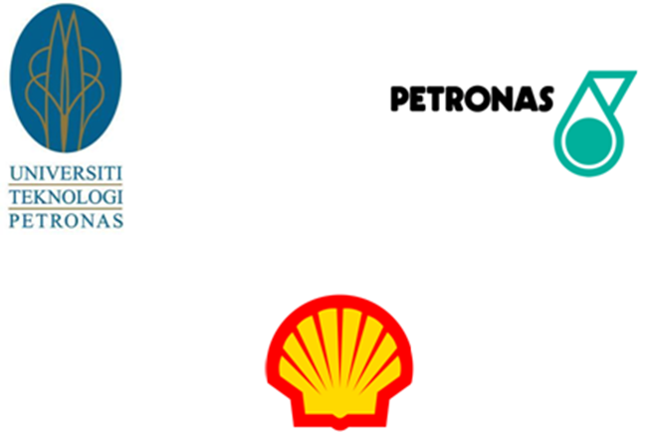
Thank you for your attention
Thanks to TU Delft, UTP, Petronas and Shell for giving me the opportunity to work on this inspiring topic.

Slide 18
Back-up slides

Slide 19
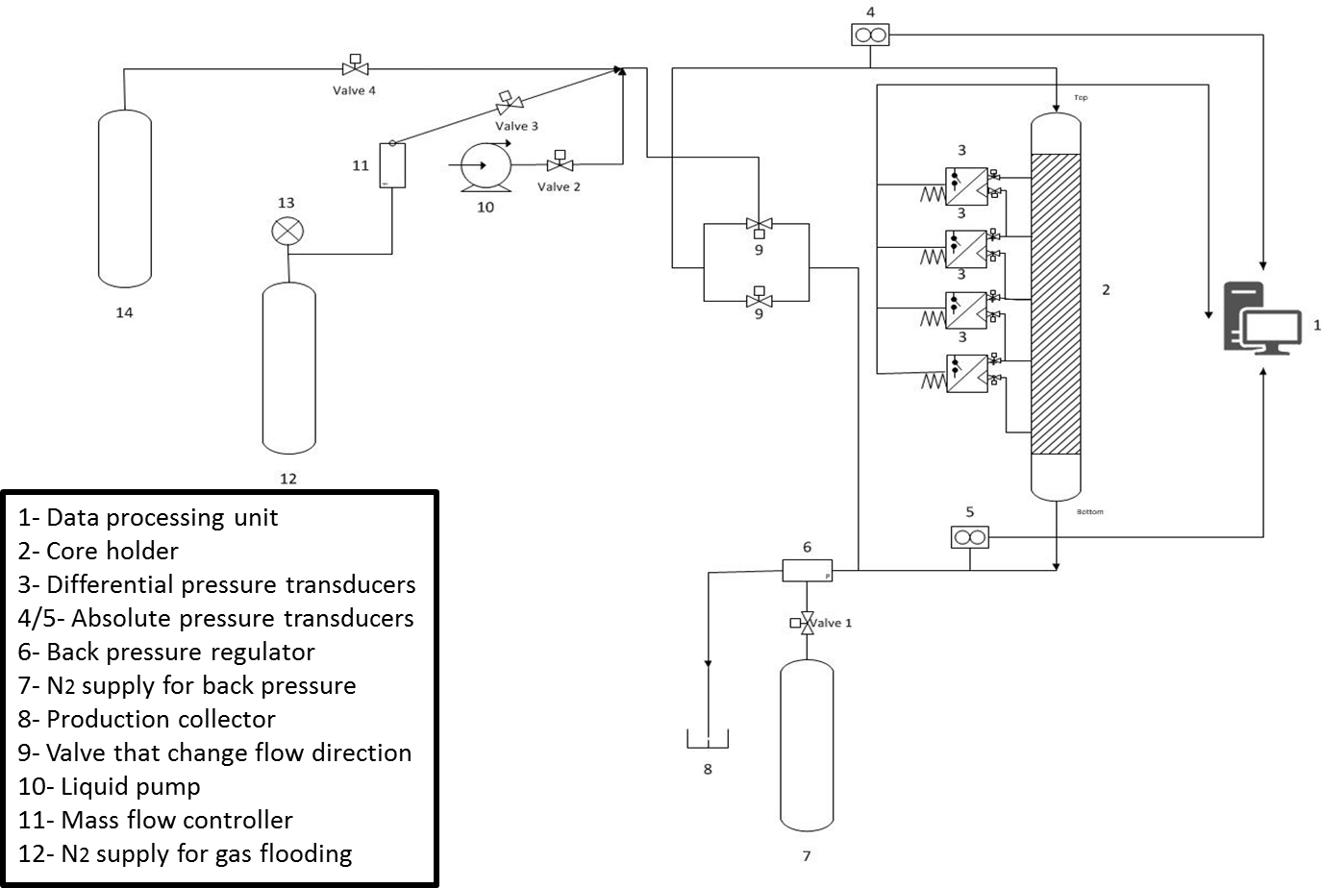
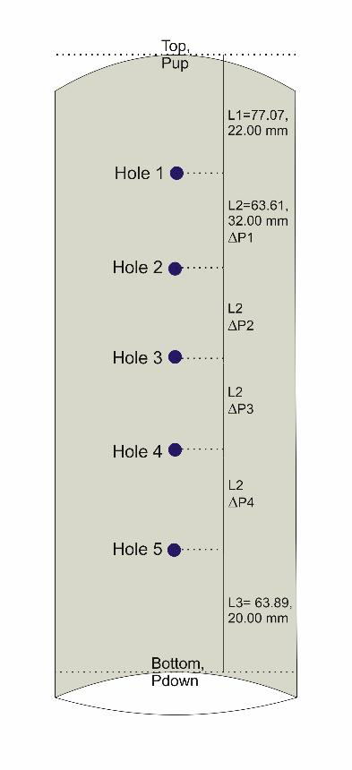
Experimental set-up
17 cm core:

Slide 20
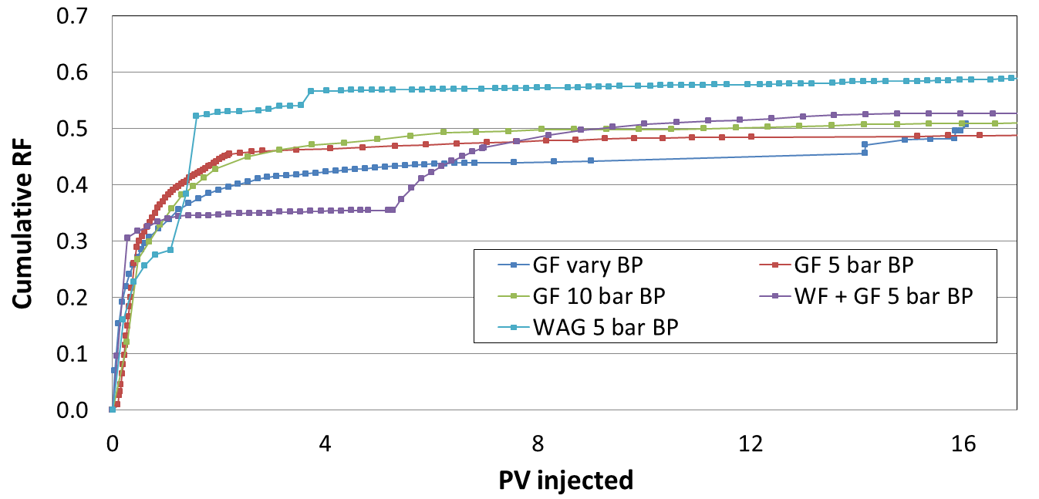
Recovery factor of all tests
RF from high to low after 17 PV:
WAG > WF + GF > GF 10 bar > GF vary BP > GF 5 bar

Slide 21
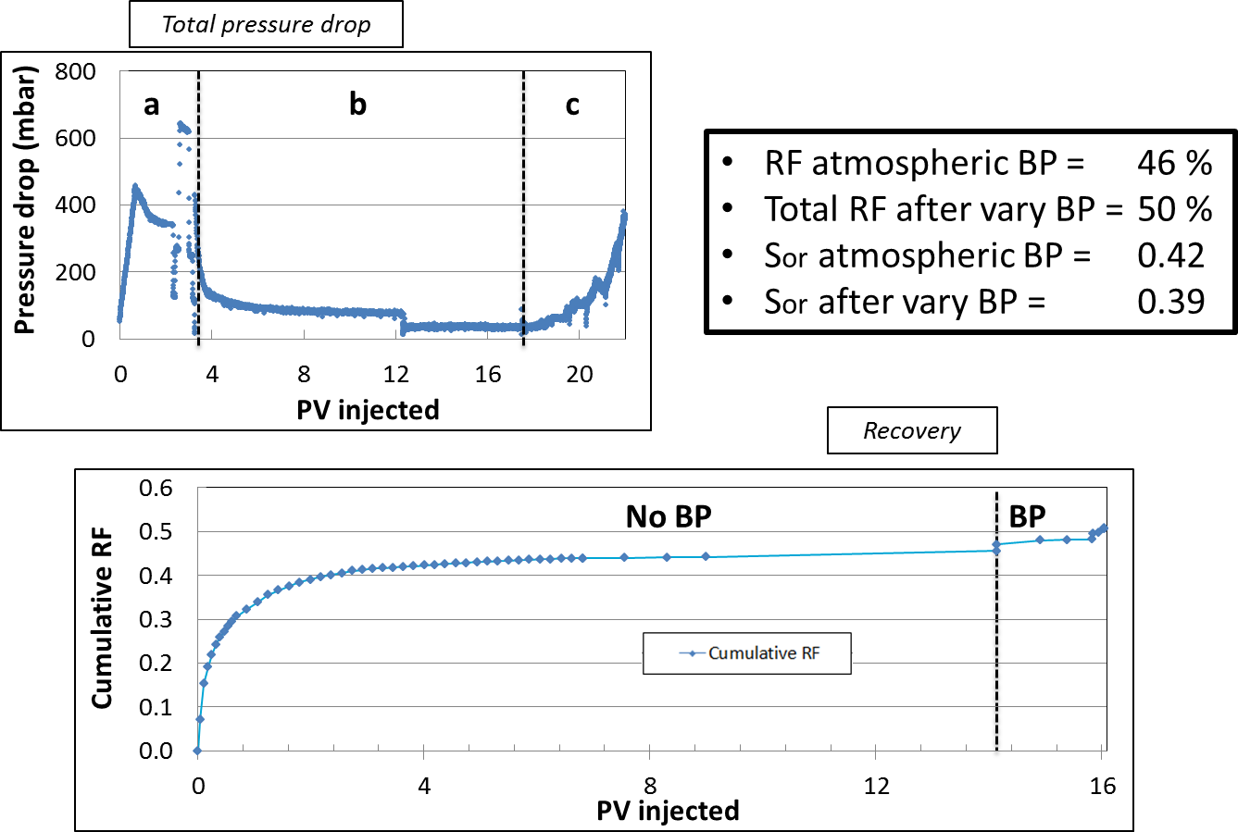
Test 1 – N2 injection while varying back pressure
Notes:
Pdrop is probably increasing at the end due to an increasing Sg → why? I don’t know.. Ask Pacelli.

Slide 22
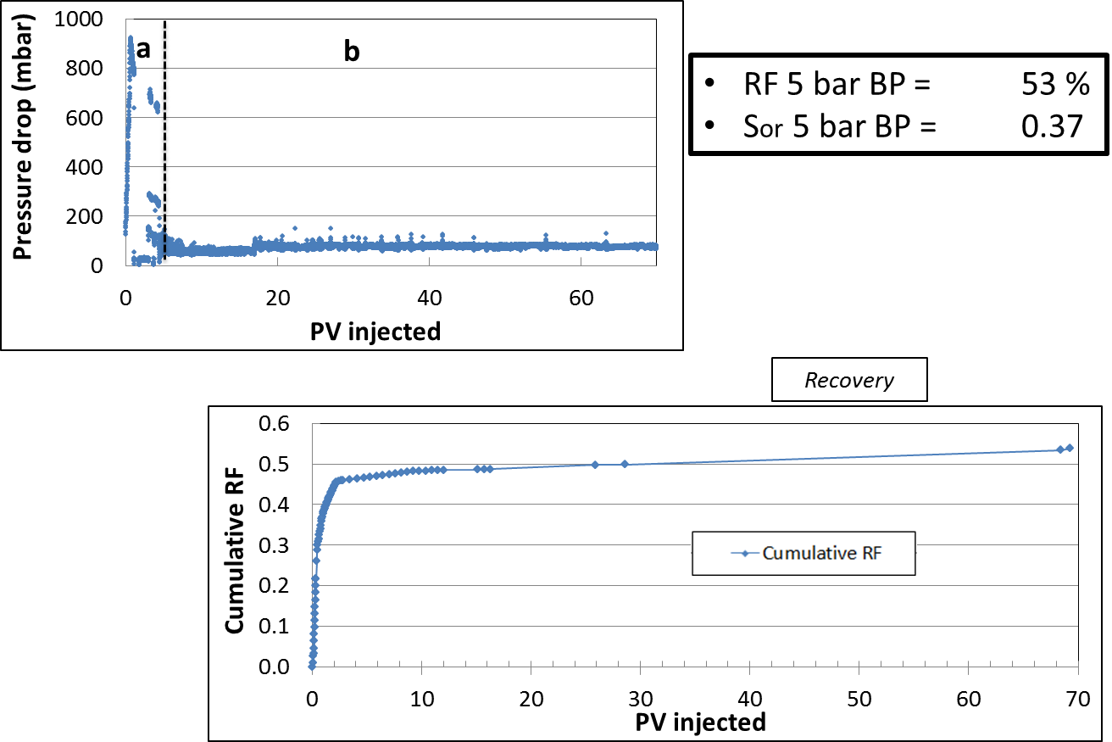
Test 2 – N2 injection at 5 bar back-pressure
Notes:
Pdrop is probably increasing at the end due to an increasing Sg → why? I don’t know.. Ask Pacelli.

Slide 23
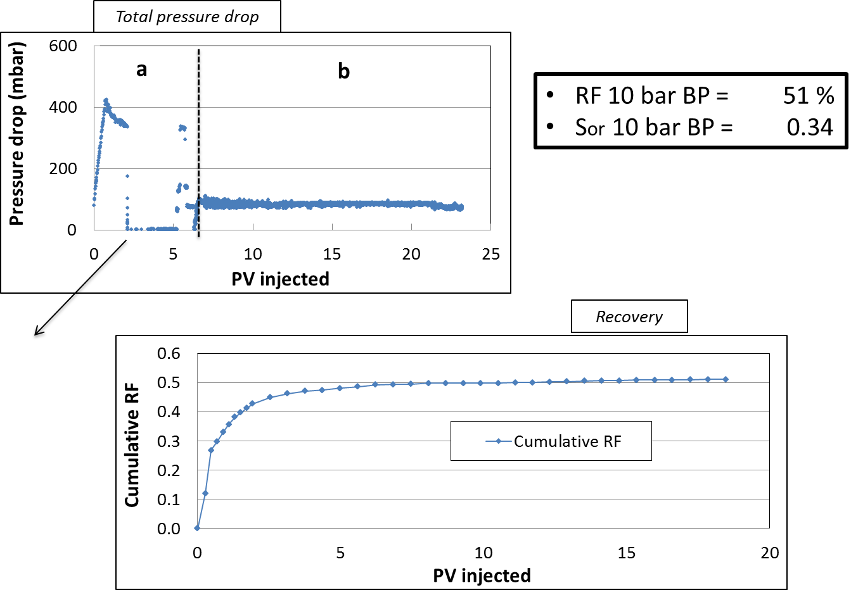
Test 3 – N2 injection at 10 bar back-pressure
Flowrate reduced
During night to 0.14
cm3/min
Notes:
Pdrop is probably increasing at the end due to an increasing Sg → why? I don’t know.. Ask Pacelli.

Slide 24
CT-scan parameters
Parameter Value
Tube current (mA) 550-250
Tube voltage (kV) 100-140
Slice thickness (mm) 2.4
Number of slices 12
Scan time (s) 1 (each energy)
Scan mode Sequential
Pixels in one CT image 512×512
Test 4 :
7.5 wt% Potassium Iodide → Brine
7.5 wt% 1-Iododecane → Oil
(bad visibility of the gas phase)
Test 5 :
15.0 wt% Potassium Iodide → Brine
5.0 wt% 1-Iododecane → Oil
CT scanning during these experiments did not gave the results we wanted
➔ Reason is that the core was placed vertically in the CT-scan.
Notes:
Adding dopant to enhance the density contrast between the oil and water phase. The values were chosen because they showed enough contrast (we thought beforehand).

Slide 25
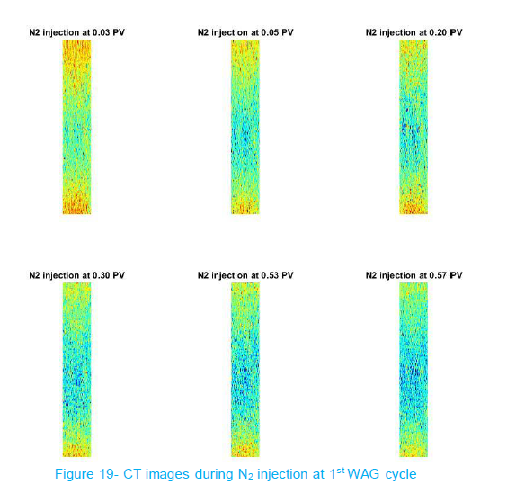
CT-scan images 1st WAG cycle
Blue/green = gas
Notes:
Pdrop is probably increasing at the end due to an increasing Sg → why? I don’t know.. Ask Pacelli.

Slide 26
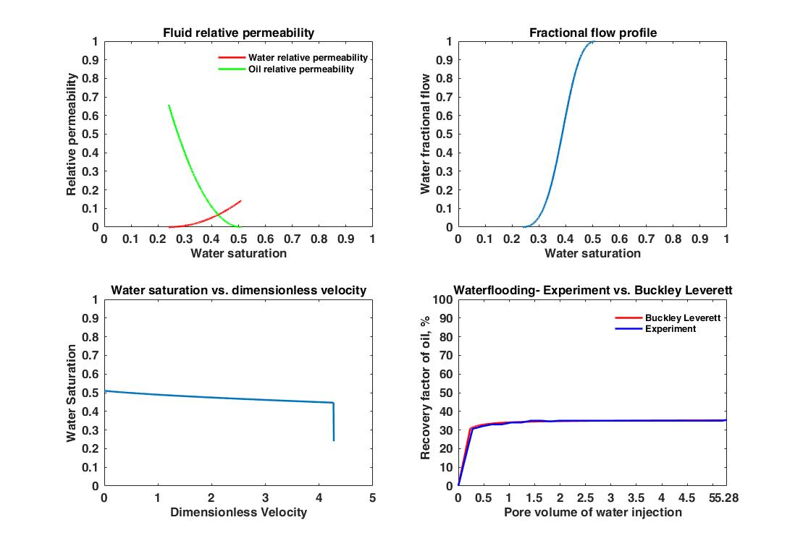
Modelling waterflooding in test 4
Krw* and Kro* measured → Brooks-Corey relation used for determing two-phase
relative permeability curves:
Notes:
Pdrop is probably increasing at the end due to an increasing Sg → why? I don’t know.. Ask Pacelli.

